Slide 1
NON- PRIMITIVE TYPES

Slide 2
Classes
Classes combine related variables (fields) and functions (methods) together.
Classes are blueprints of objects.
To create a class we start by an access modifier , the keyword class and the name of the class .

Slide 3
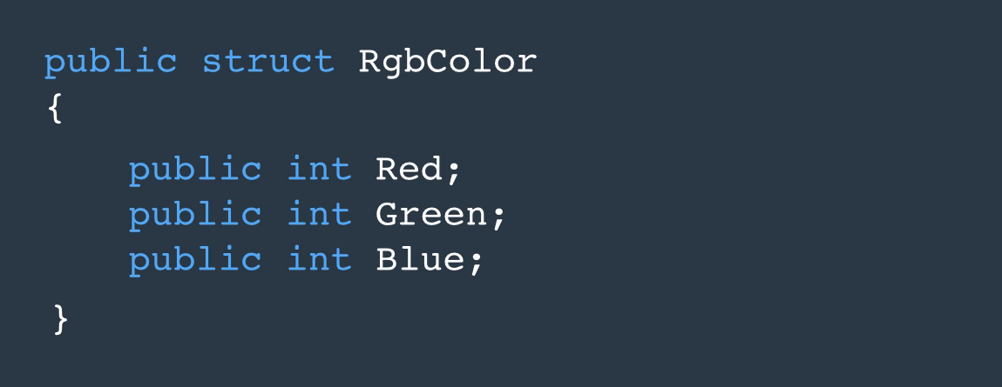
Structs
Declaring structs. Structures combine related method together

Slide 4
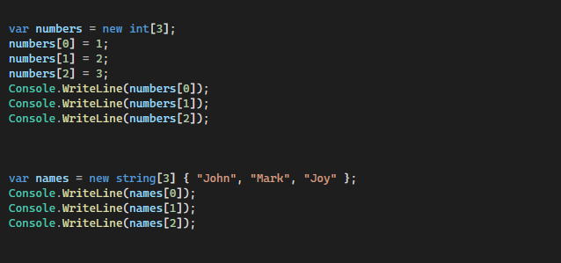
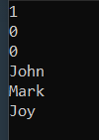
Array
A data structure that is used to store a collection of variables of the same type,
Arrays have a fixed size and you use the new operator

Slide 5
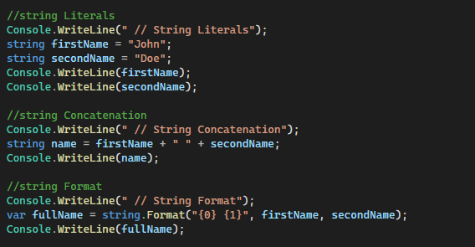
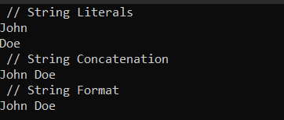
Strings
A sequence of characters, we use double quotes not single quotes.
Ways of creating strings:
String Literal
String literal is a way of declaring strings where by we use double quotes

Slide 6
Enum
A set of name/value pairs of related constants

Slide 7
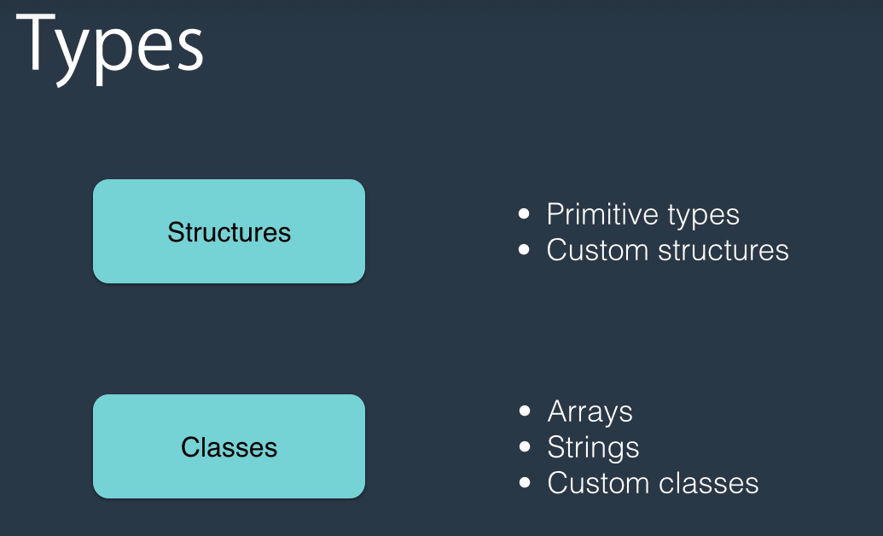
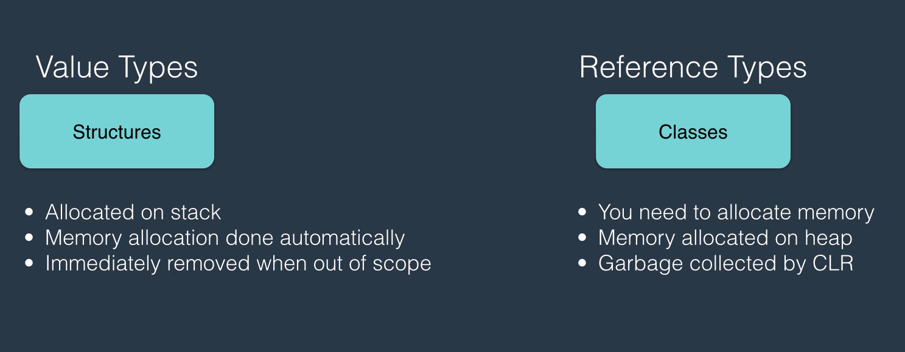
Reference Vs Value Types

Slide 8

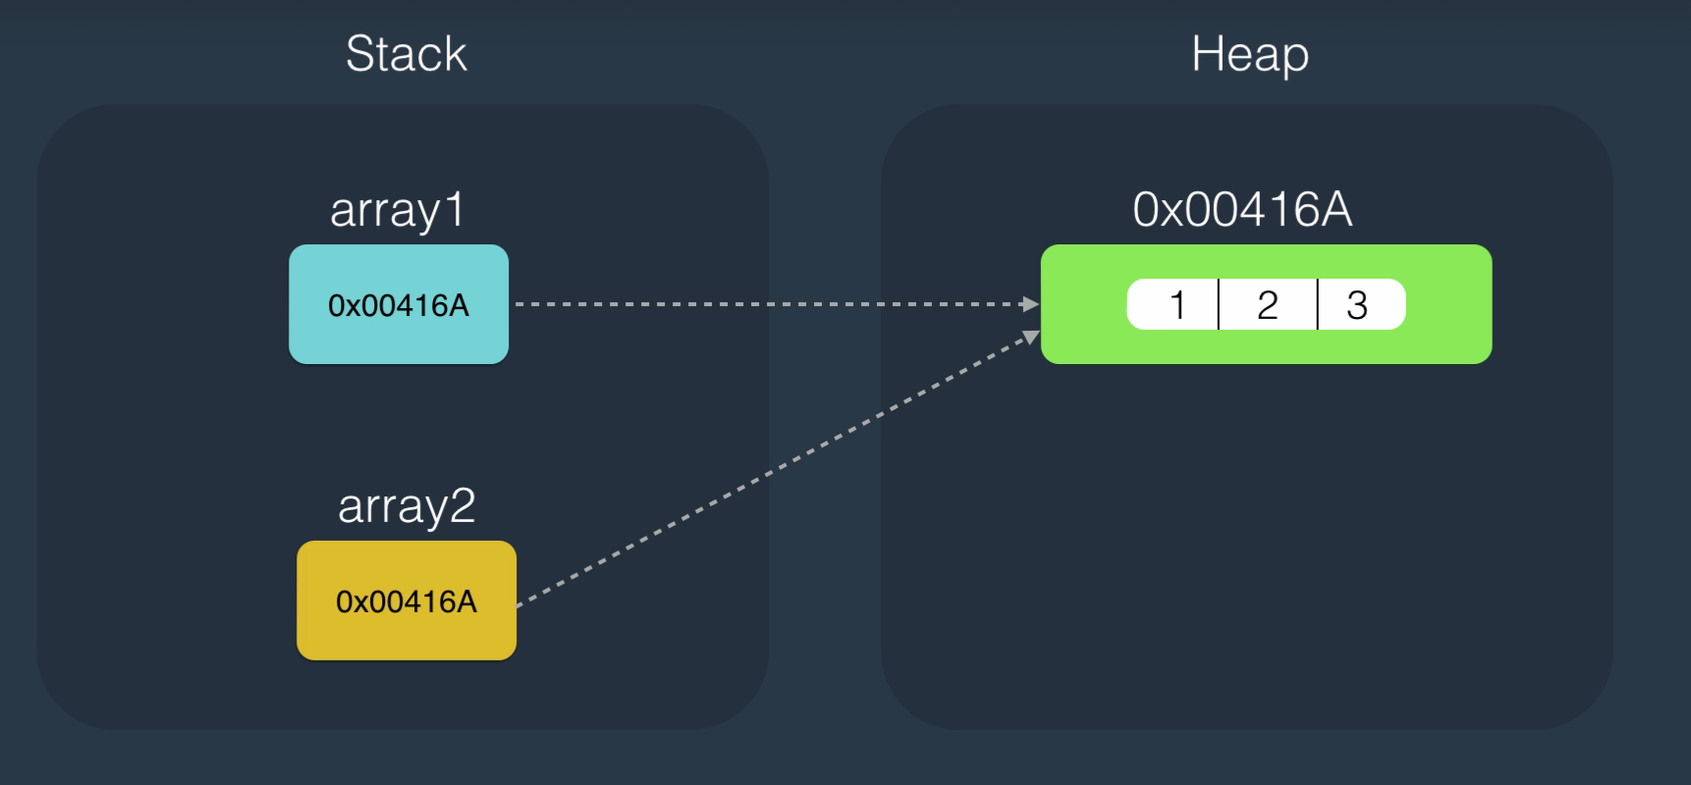
Reference Types

Slide 9
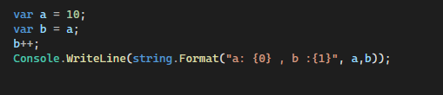
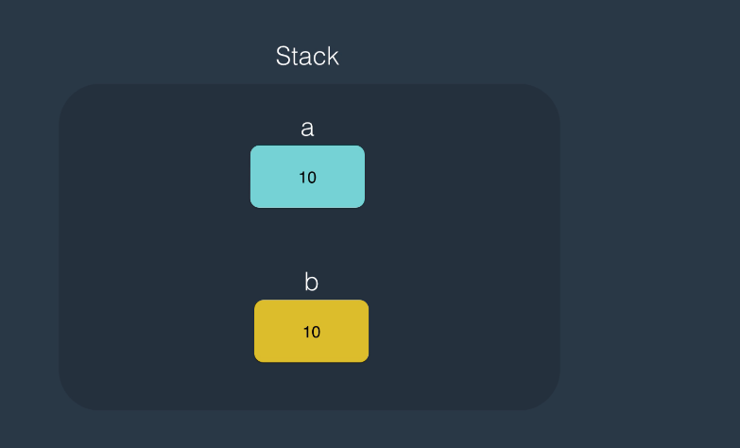
Value Types

Slide 10
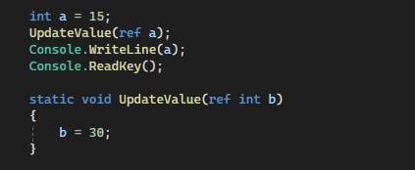
Using Ref keyword

